Slide 1
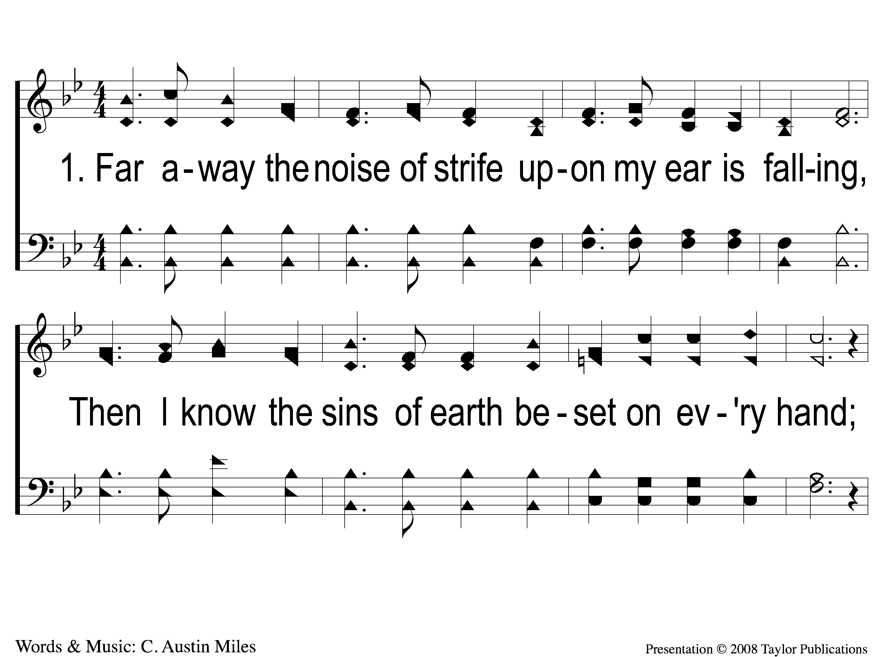
1-1 Dwelling in Beulah Land
Dwelling in Beulah Land
89

Slide 2
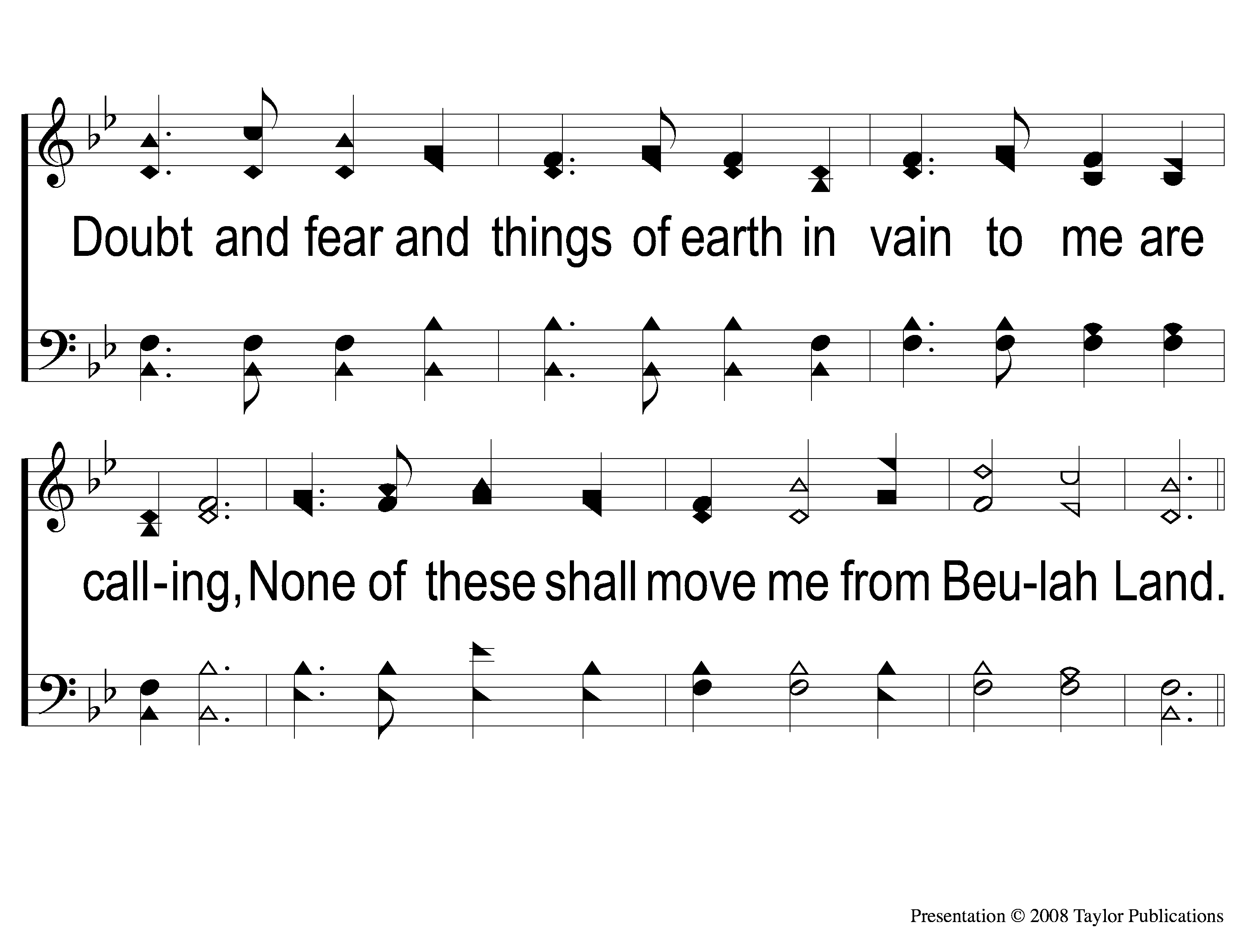
1-2 Dwelling in Beulah Land
Dwelling in Beulah Land
89

Slide 3
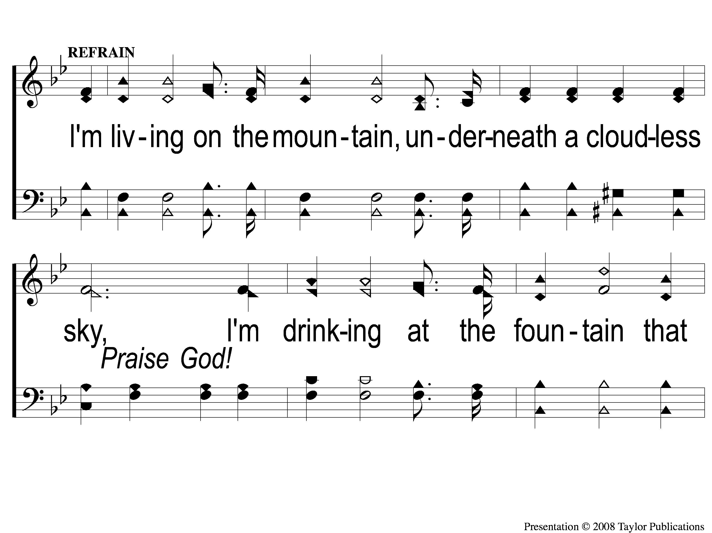
C-1 Dwelling in Beulah Land
Dwelling in Beulah Land
89

Slide 4
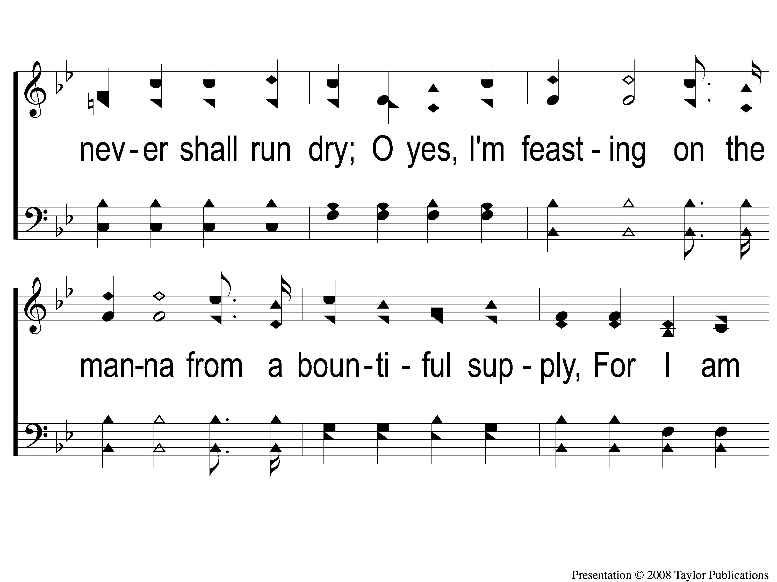
C-2 Dwelling in Beulah Land
Dwelling in Beulah Land
89

Slide 5
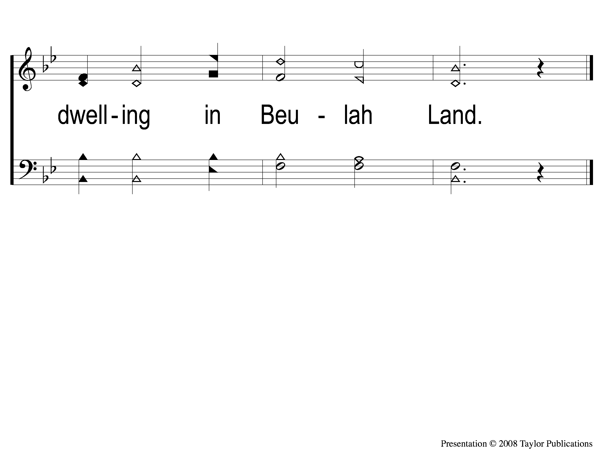
C-3 Dwelling in Beulah Land
Dwelling in Beulah Land
89

Slide 6
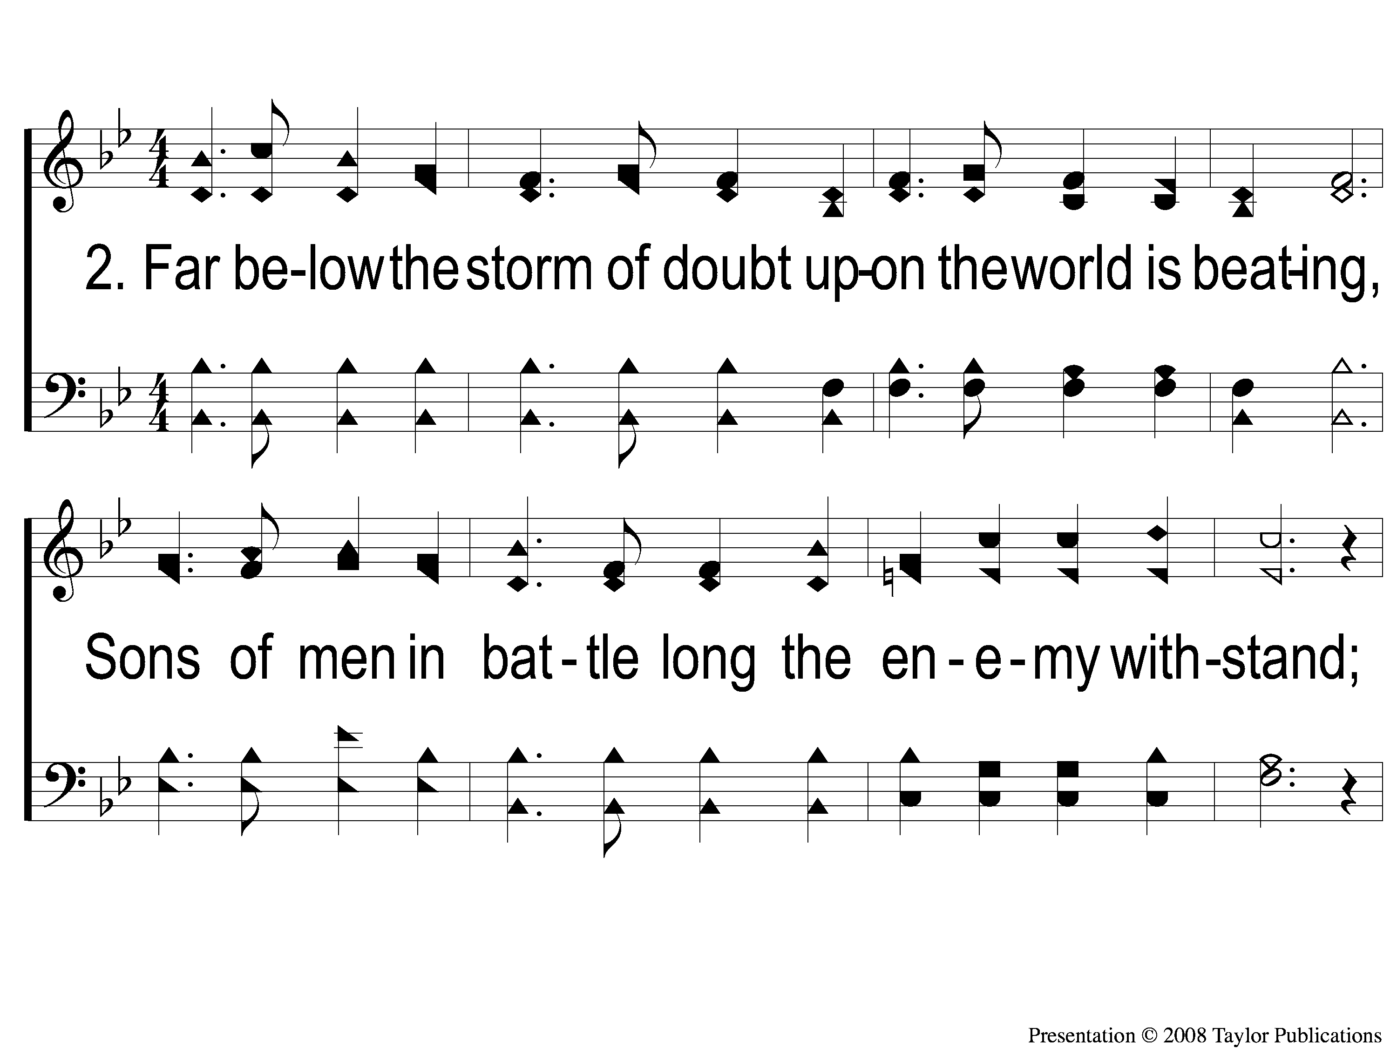
2-1 Dwelling in Beulah Land
Dwelling in Beulah Land
89

Slide 7
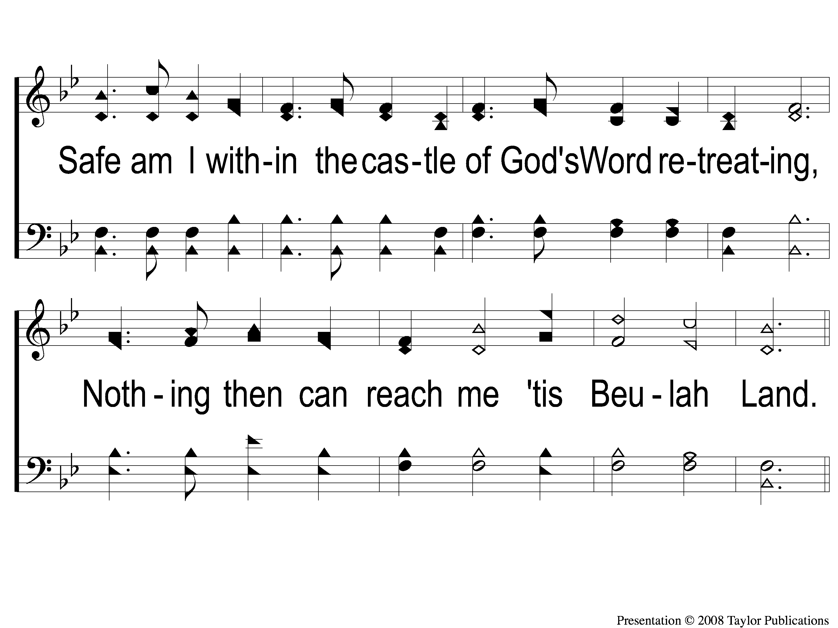
2-2 Dwelling in Beulah Land
Dwelling in Beulah Land
89

Slide 8
C-1 Dwelling in Beulah Land
Dwelling in Beulah Land
89

Slide 9
C-2 Dwelling in Beulah Land
Dwelling in Beulah Land
89

Slide 10
C-3 Dwelling in Beulah Land
Dwelling in Beulah Land
89

Slide 11
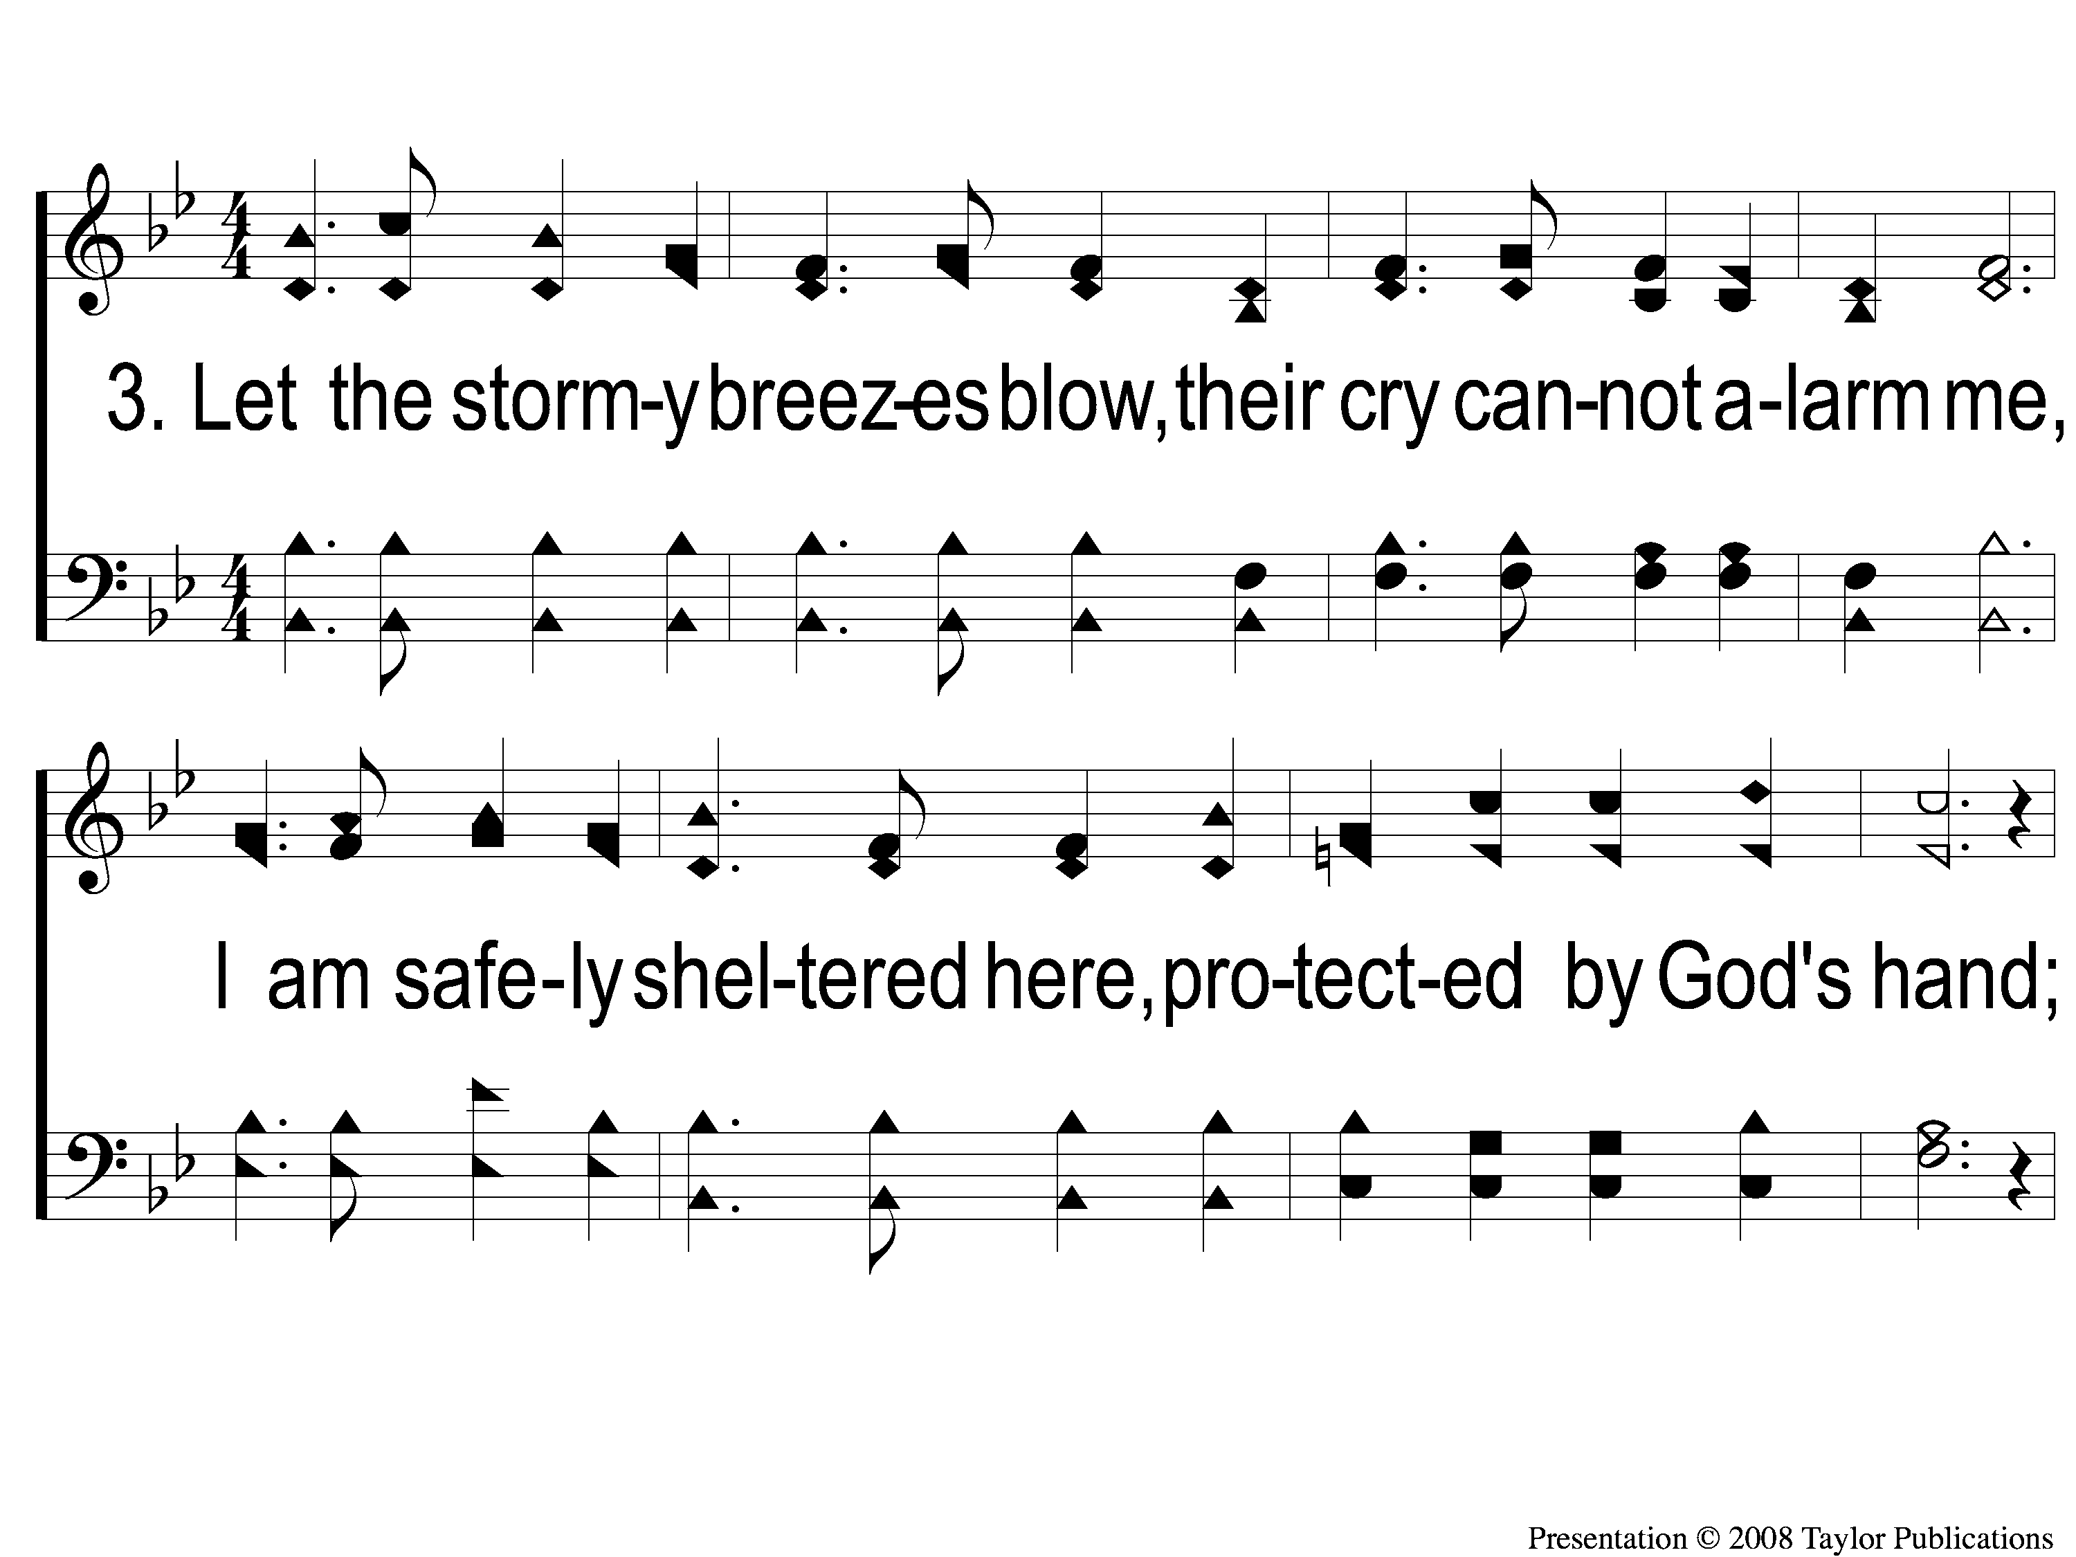
3-1 Dwelling in Beulah Land
Dwelling in Beulah Land
89

Slide 12
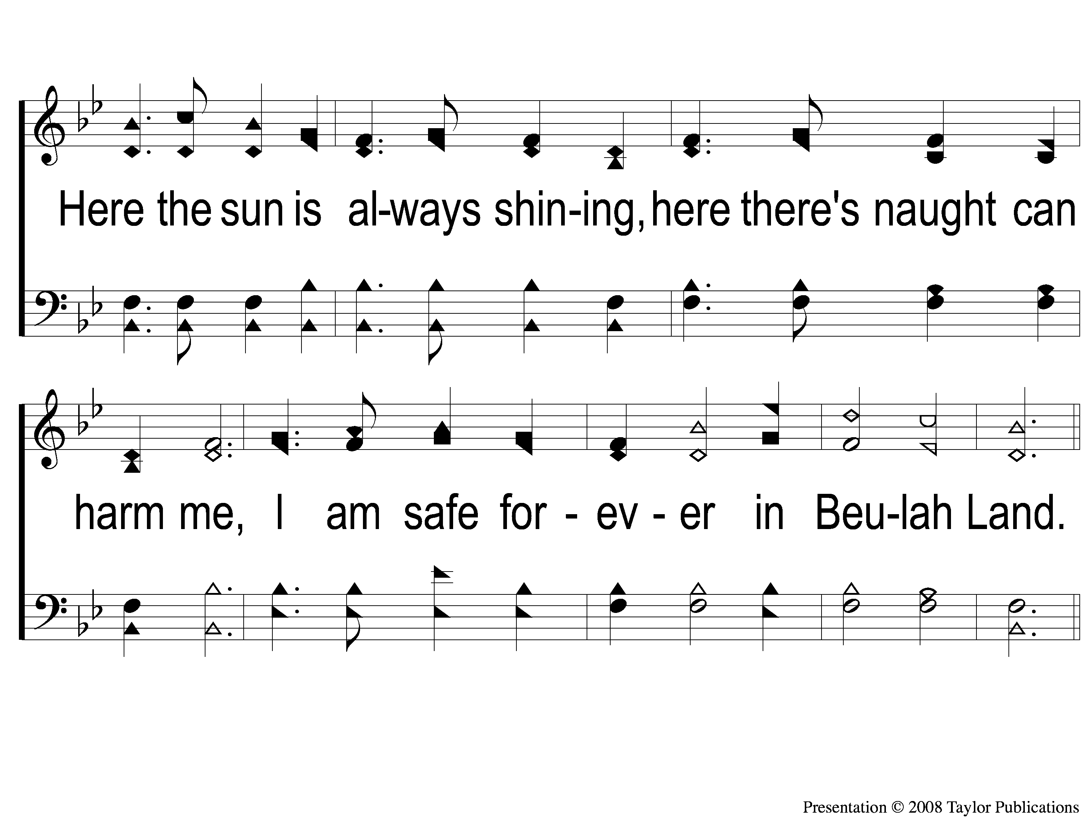
3-2 Dwelling in Beulah Land
Dwelling in Beulah Land
89

Slide 13
C-1 Dwelling in Beulah Land
Dwelling in Beulah Land
89

Slide 14
C-2 Dwelling in Beulah Land
Dwelling in Beulah Land
89

Slide 15
C-3 Dwelling in Beulah Land
Dwelling in Beulah Land
89

Slide 16
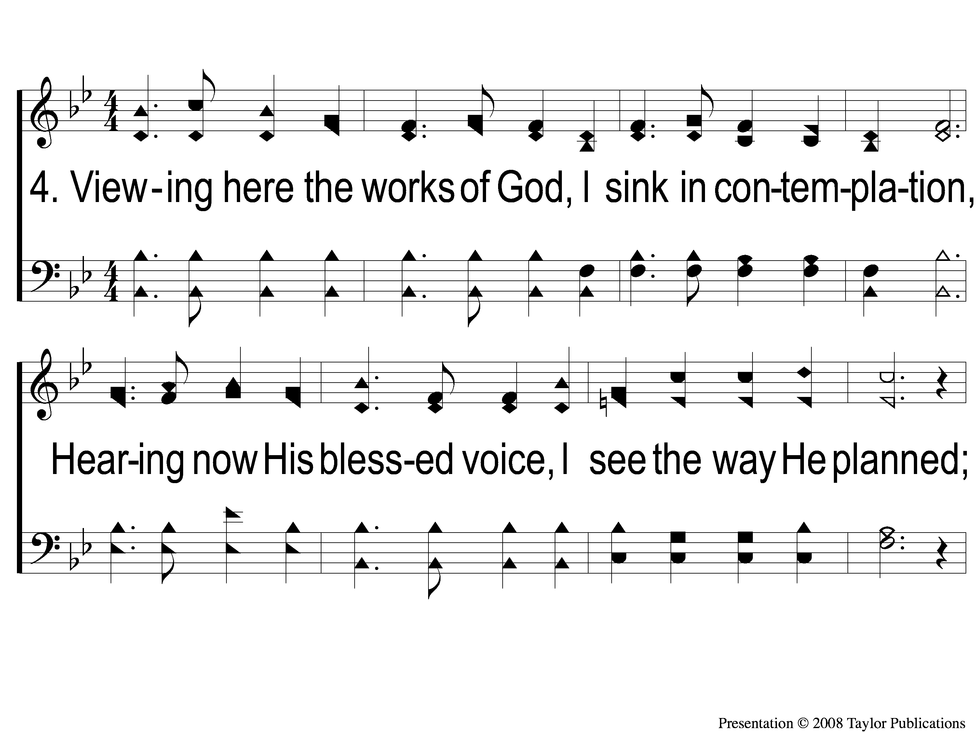
4-1 Dwelling in Beulah Land
Dwelling in Beulah Land
89

Slide 17
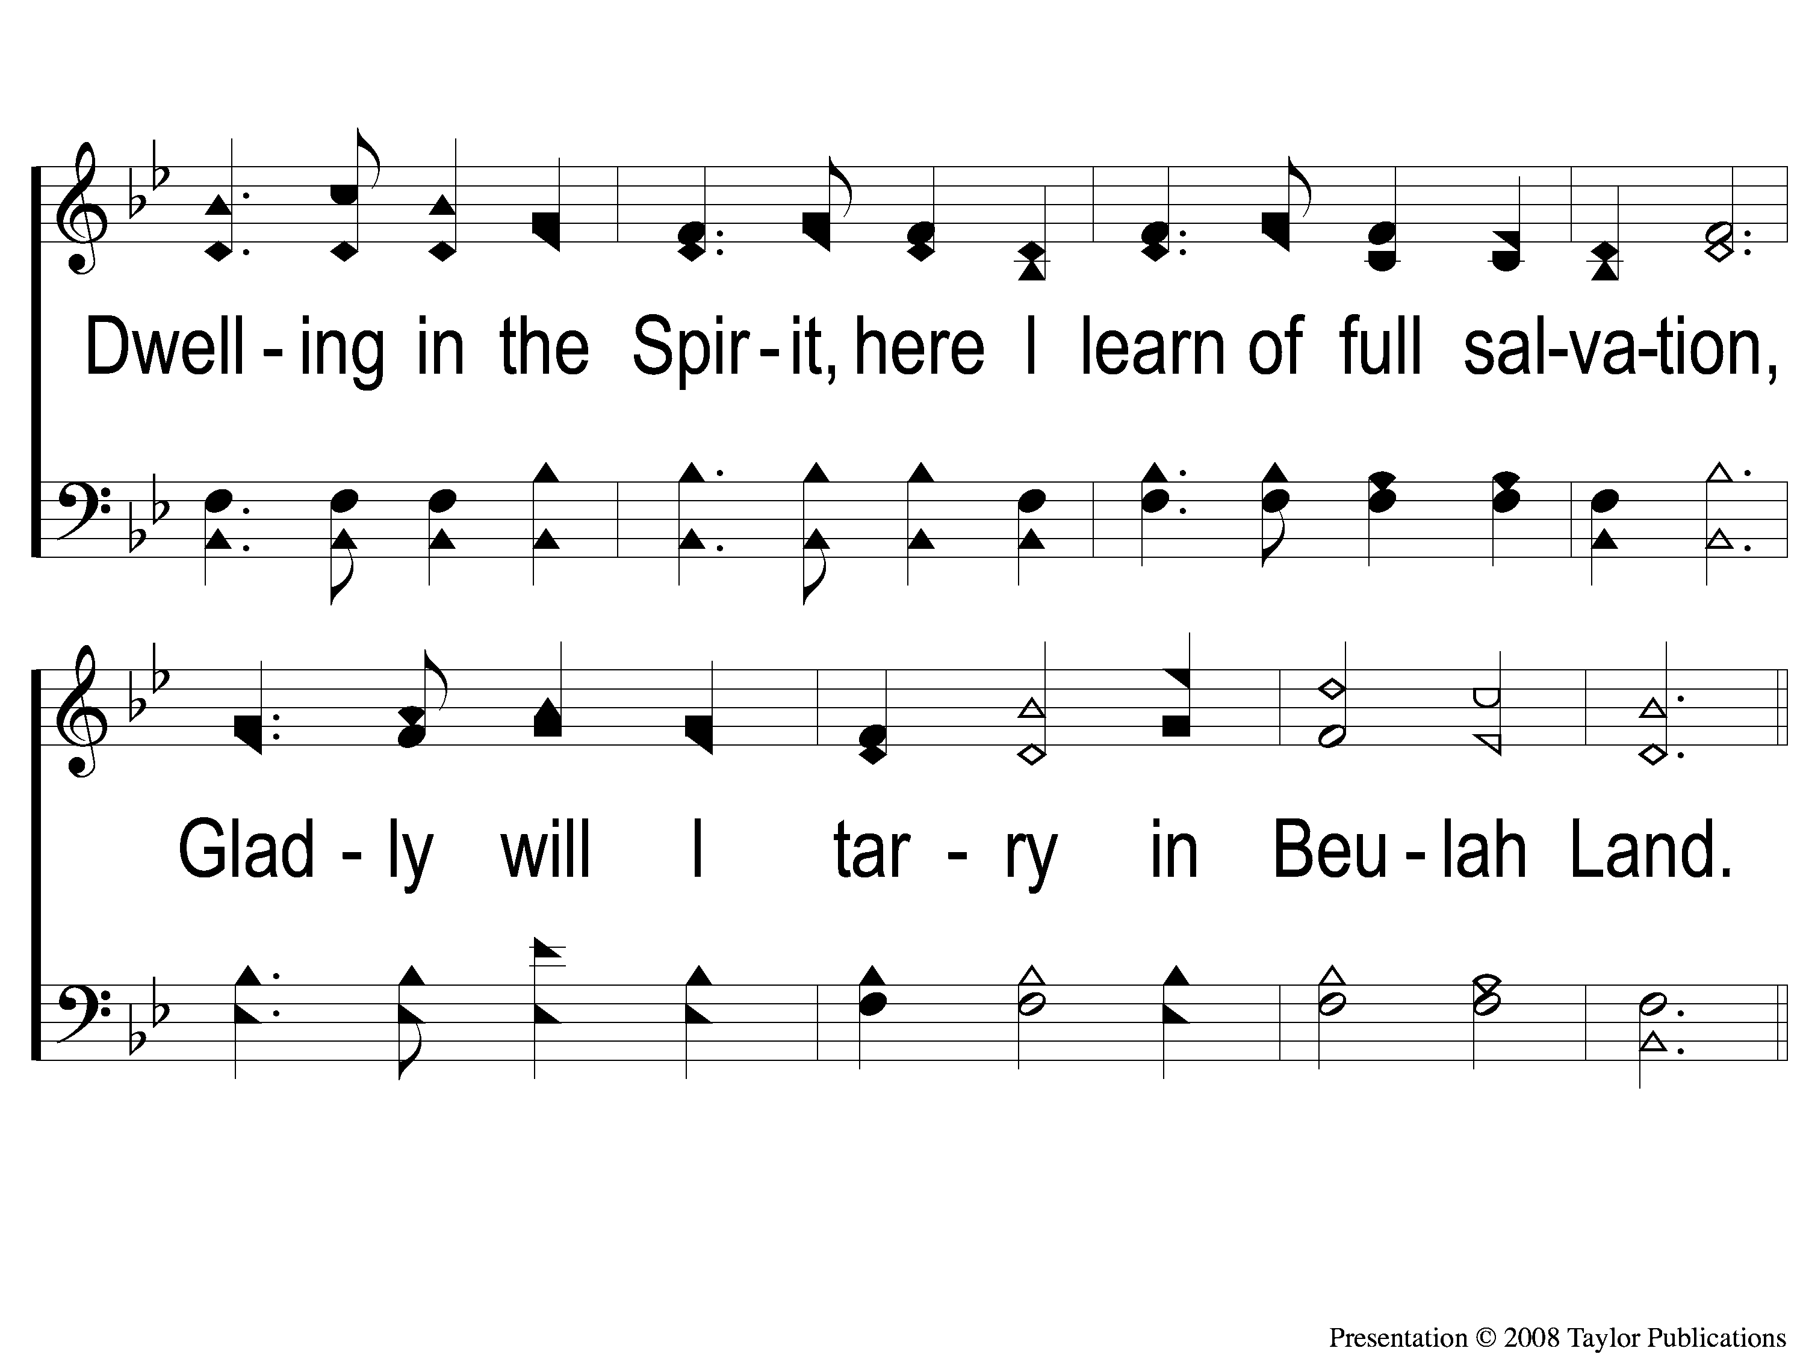
4-2 Dwelling in Beulah Land
Dwelling in Beulah Land
89

Slide 18
C-1 Dwelling in Beulah Land
Dwelling in Beulah Land
89

Slide 19
C-2 Dwelling in Beulah Land
Dwelling in Beulah Land
89

Slide 20
C-3 Dwelling in Beulah Land
Dwelling in Beulah Land
89

